Slide 1
MPOPF Simulation and OpenDSS Validation
Aryan Ritwajeet Jha
Graduate Research Assistant
Washington State University
Notes:
Remember to hit the reset button to make sure all the page elements react properly.
There are 20 different layouts that you can choose from.

Slide 2
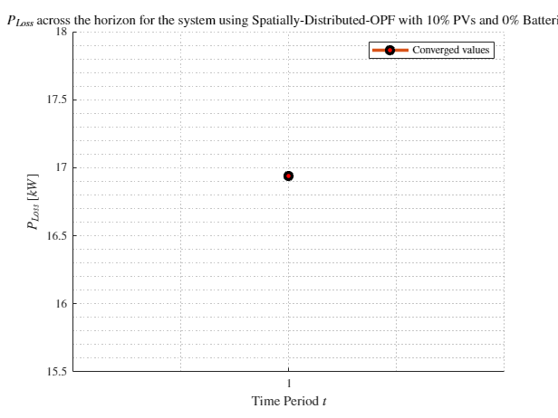
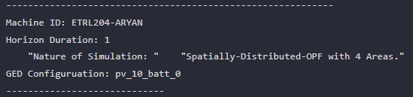
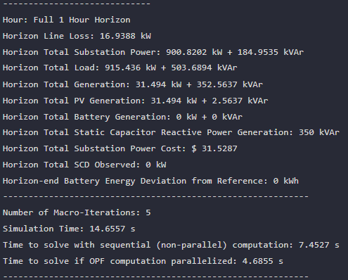
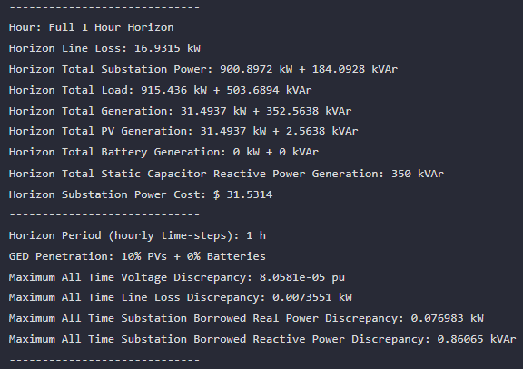

MPDOPF Verified for $T=1, PV=10\%, Batt=0\%$
strLoadShape = 'New Loadshape.LoadShape npts =1 interval = 1 mult = [0.787]'
strLoadShapePV = 'New Loadshape.LoadShapePV npts =1 interval = 1 mult = [0.9]'
MPDOPF Simulation Results
OpenDSS Powerflow Results

Slide 3
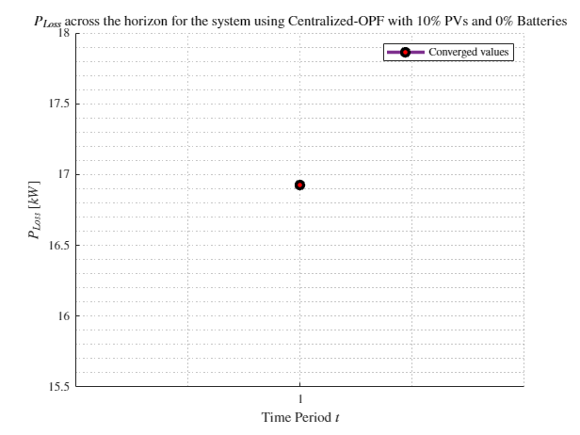
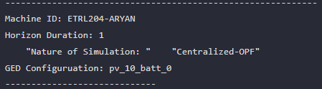
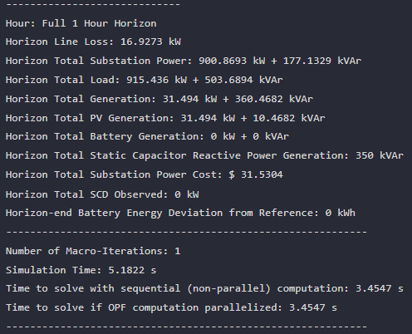
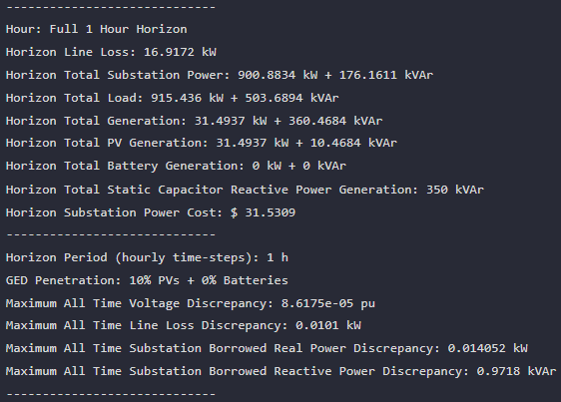

MPCOPF Verified for $T=1, PV=10\%, Batt=0\%$
strLoadShape = 'New Loadshape.LoadShape npts =1 interval = 1 mult = [0.787]'
strLoadShapePV = 'New Loadshape.LoadShapePV npts =1 interval = 1 mult = [0.9]'
MPCOPF Simulation Results
OpenDSS Powerflow Results

Slide 4
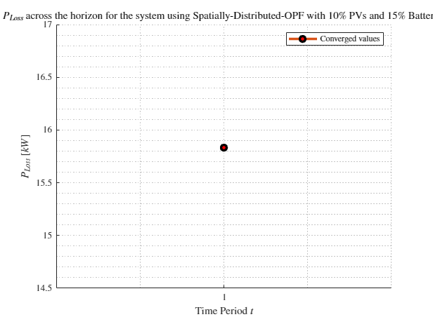
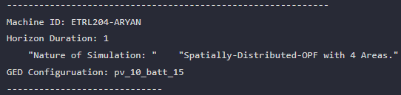
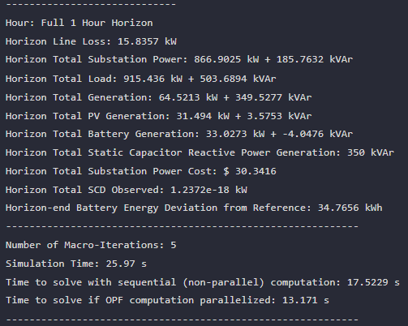
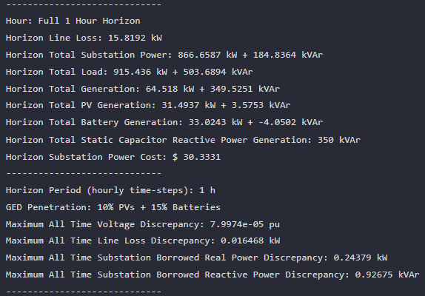

MPDOPF Verified for $T=1, PV=10\%, Batt=15\%$
strLoadShape = 'New Loadshape.LoadShape npts =1 interval = 1 mult = [0.787]'
strLoadShapePV = 'New Loadshape.LoadShapePV npts =1 interval = 1 mult = [0.9]'
MPDOPF Simulation Results
OpenDSS Powerflow Results

Slide 5
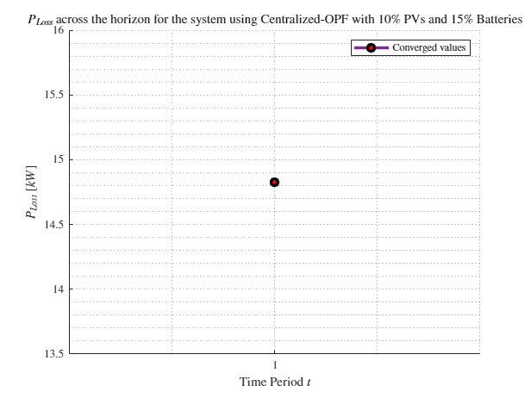
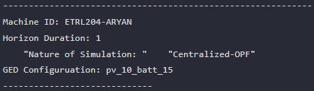
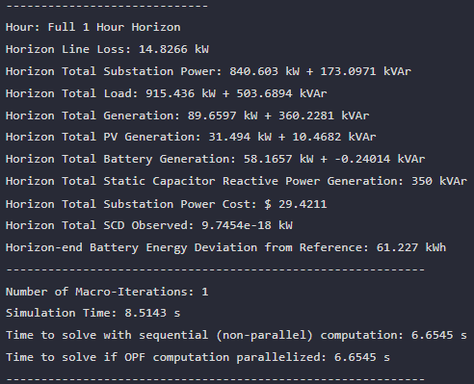
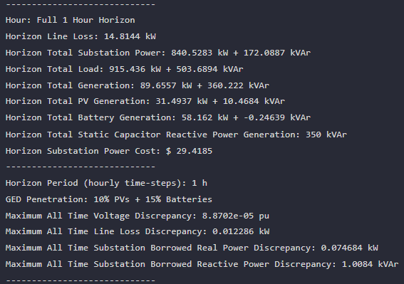

MPCOPF Verified for $T=1, PV=10\%, Batt=15\%$
strLoadShape = 'New Loadshape.LoadShape npts =1 interval = 1 mult = [0.787]'
strLoadShapePV = 'New Loadshape.LoadShapePV npts =1 interval = 1 mult = [0.9]'
MPCOPF Simulation Results
OpenDSS Powerflow Results

Slide 6
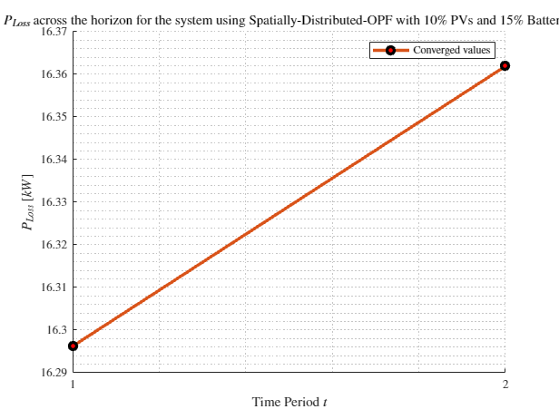
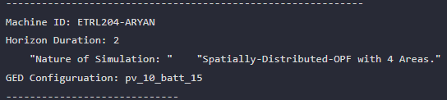
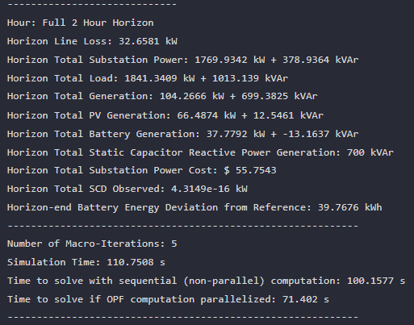
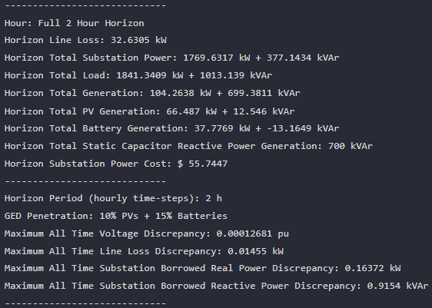

MPDOPF Verified for $T=2, PV=10\%, Batt=15\%$
strLoadShape = 'New Loadshape.LoadShape npts =2 interval = 1 mult = [0.787 0.796]'
strLoadShapePV = 'New Loadshape.LoadShapePV npts =2 interval = 1 mult = [0.9 1]'
MPDOPF Simulation Results
OpenDSS Powerflow Results

Slide 7
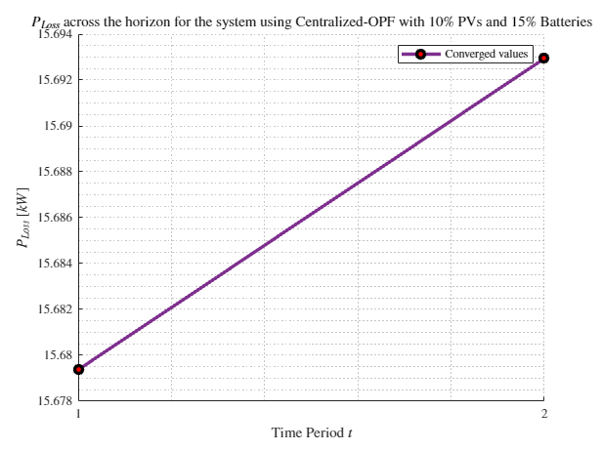
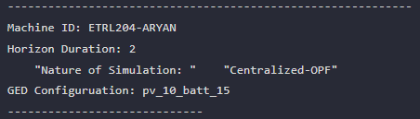
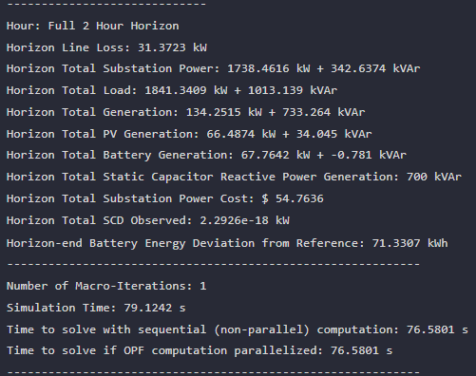
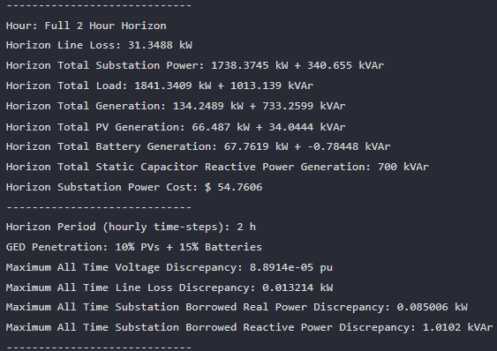

MPCOPF Verified for $T=2, PV=10\%, Batt=15\%$
strLoadShape = 'New Loadshape.LoadShape npts =2 interval = 1 mult = [0.787 0.796]'
strLoadShapePV = 'New Loadshape.LoadShapePV npts =2 interval = 1 mult = [0.9 1]'
MPCOPF Simulation Results
OpenDSS Powerflow Results

Slide 8

MPDOPF Verified for $T=3, PV=10\%, Batt=15\%$
strLoadShape = 'New Loadshape.LoadShape npts =3 interval = 1 mult = [0.777 0.787 0.796]'
strLoadShapePV = 'New Loadshape.LoadShapePV npts =3 interval = 1 mult = [0.8 0.9 1]'
MPDOPF Simulation Results
OpenDSS Powerflow Results

Slide 9
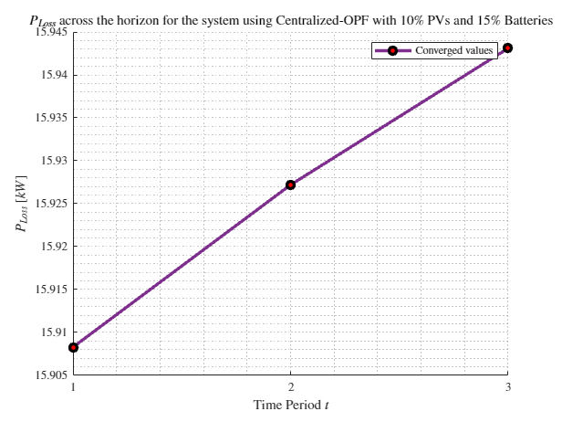
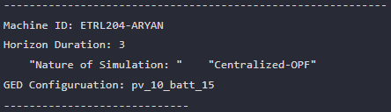
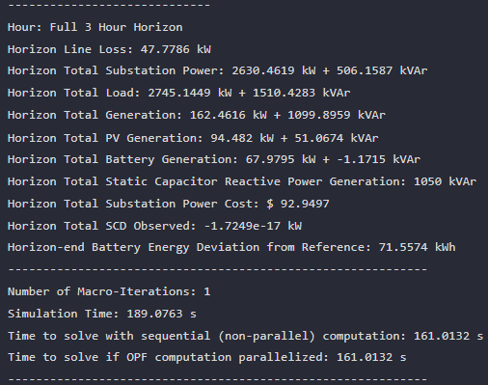
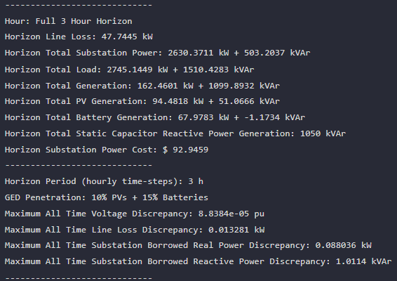

MPCOPF Verified for $T=3, PV=10\%, Batt=15\%$
strLoadShape = 'New Loadshape.LoadShape npts =3 interval = 1 mult = [0.777 0.787 0.796]'
strLoadShapePV = 'New Loadshape.LoadShapePV npts =3 interval = 1 mult = [0.8 0.9 1]'
MPCOPF Simulation Results
OpenDSS Powerflow Results

Slide 10
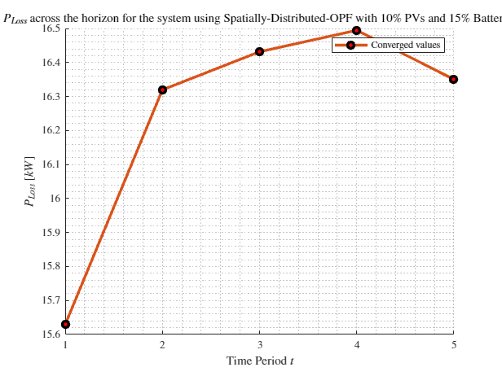
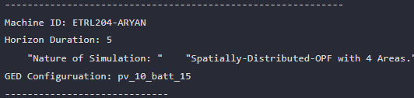
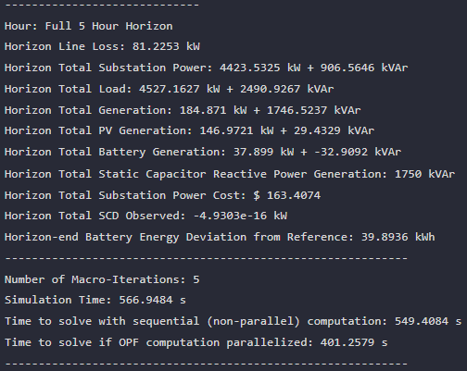
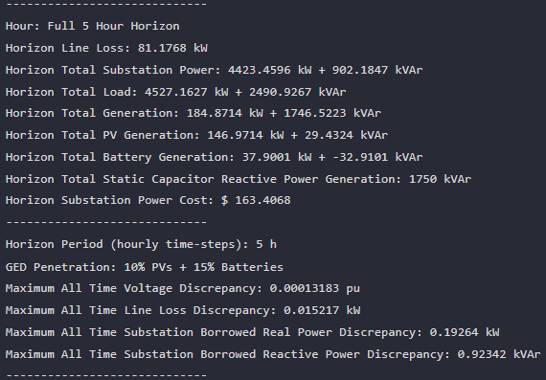

MPDOPF Verified for $T=5, PV=10\%, Batt=15\%$
strLoadShape = 'New Loadshape.LoadShape npts =5 interval = 1 mult = [0.75 0.777 0.787 0.796 0.782]'
strLoadShapePV = 'New Loadshape.LoadShapePV npts =5 interval = 1 mult = [0.5 0.8 0.9 1 1]'
MPDOPF Simulation Results
OpenDSS Powerflow Results

Slide 11
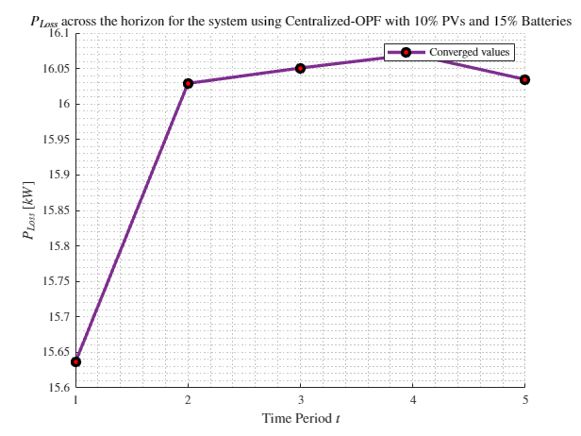
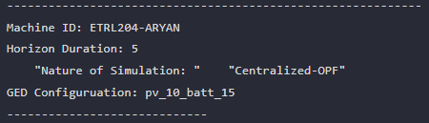
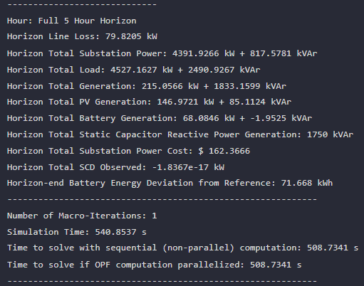
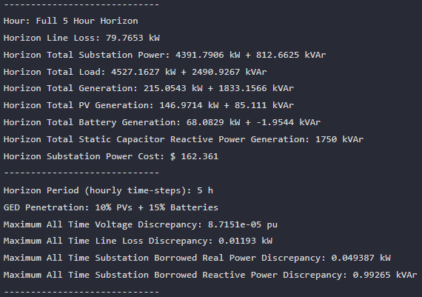

MPCOPF Verified for $T=5, PV=10\%, Batt=15\%$
strLoadShape = 'New Loadshape.LoadShape npts =5 interval = 1 mult = [0.75 0.777 0.787 0.796 0.782]'
strLoadShapePV = 'New Loadshape.LoadShapePV npts =5 interval = 1 mult = [0.5 0.8 0.9 1 1]'
MPCOPF Simulation Results
OpenDSS Powerflow Results

Slide 12
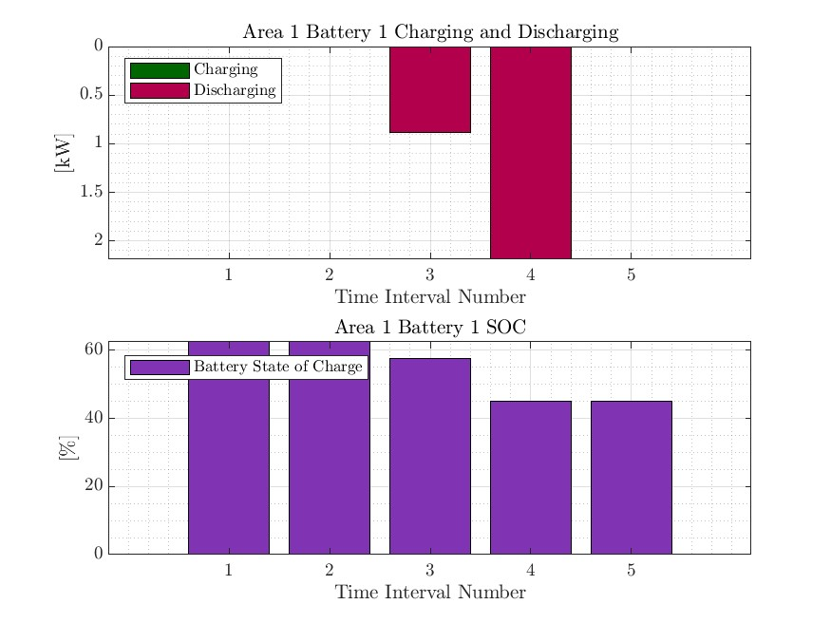
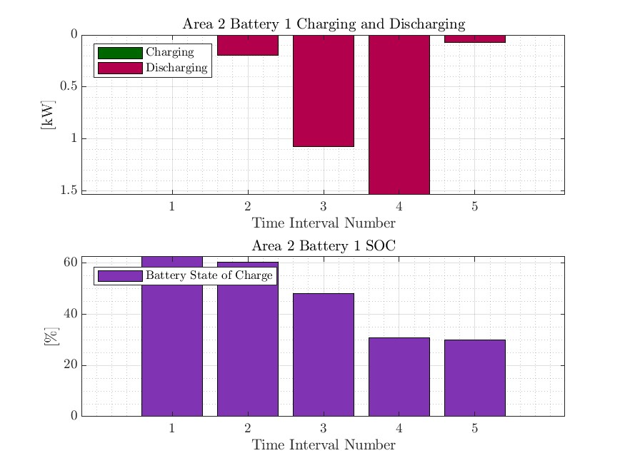
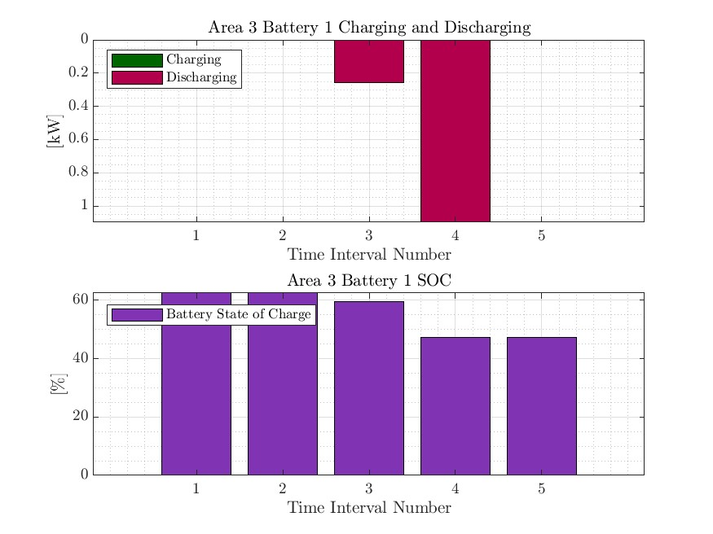
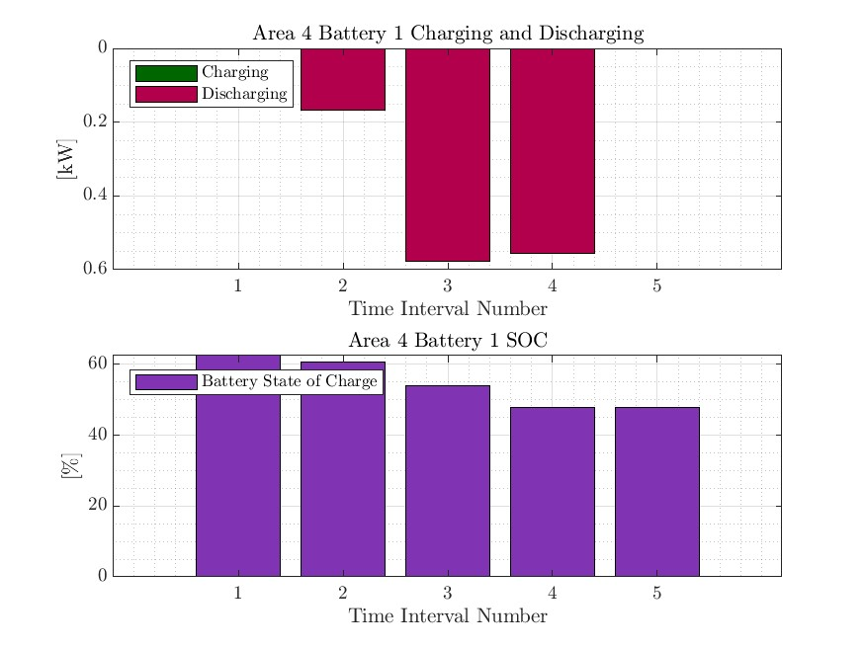

MPDOPF Verified for $T=5, PV=10\%, Batt=15\%$
strLoadShape = 'New Loadshape.LoadShape npts =5 interval = 1 mult = [0.75 0.777 0.787 0.796 0.782]'
strLoadShapePV = 'New Loadshape.LoadShapePV npts =5 interval = 1 mult = [0.5 0.8 0.9 1 1]'

Slide 13
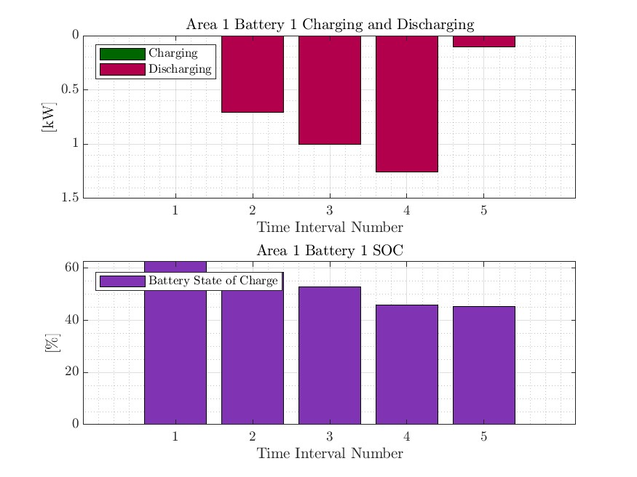
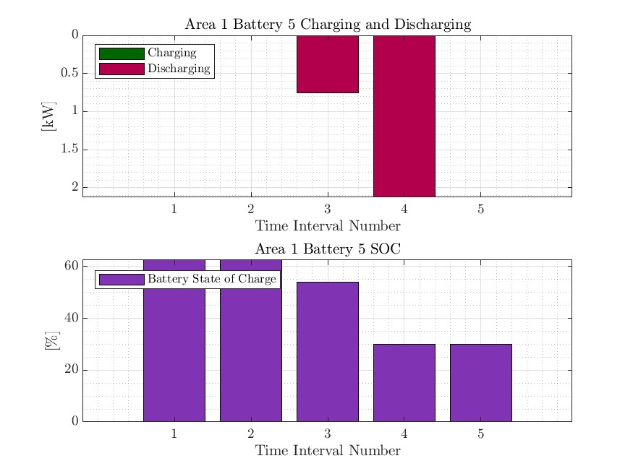
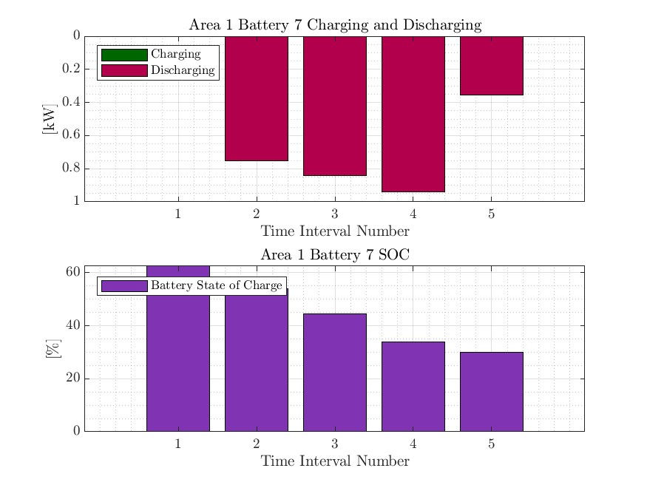
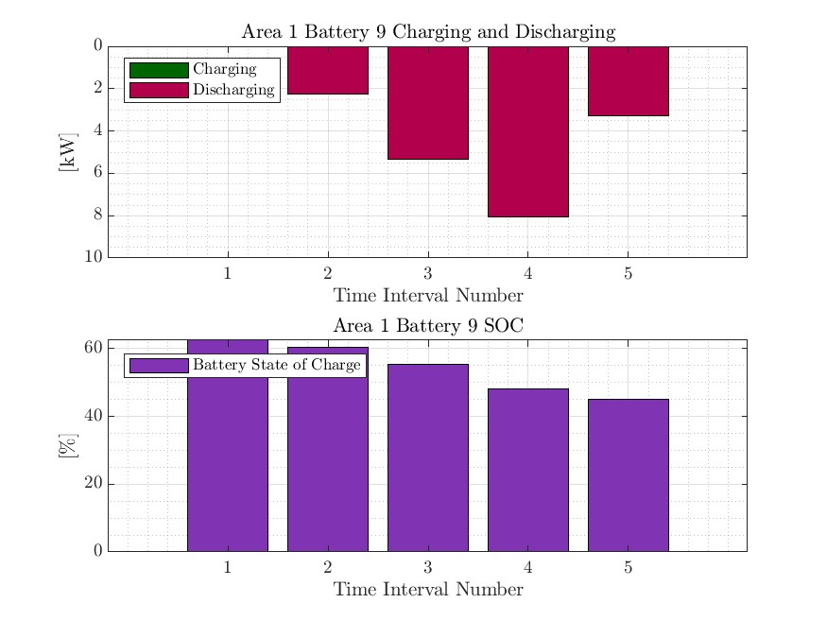

MPCOPF Verified for $T=5, PV=10\%, Batt=15\%$
strLoadShape = 'New Loadshape.LoadShape npts =5 interval = 1 mult = [0.75 0.777 0.787 0.796 0.782]'
strLoadShapePV = 'New Loadshape.LoadShapePV npts =5 interval = 1 mult = [0.5 0.8 0.9 1 1]'

Slide 14
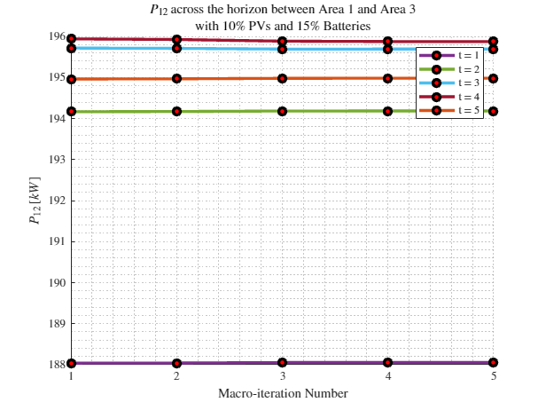
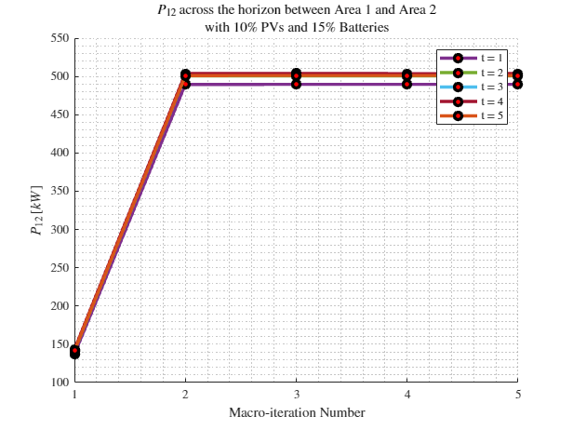
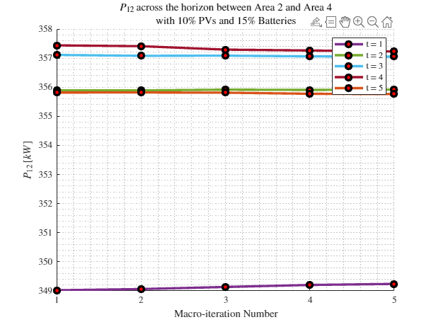

Boundary Complex Powers
MPDOPF Verified for $T=5, PV=10\%, Batt=15\%$

Slide 15
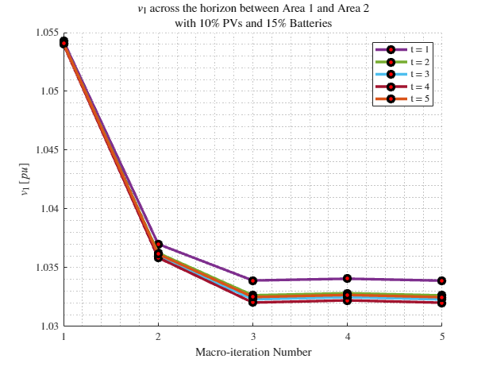
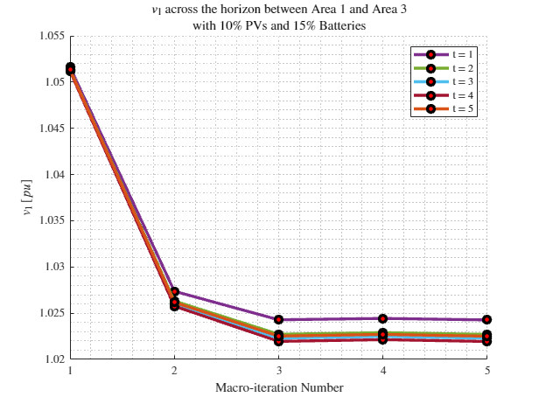
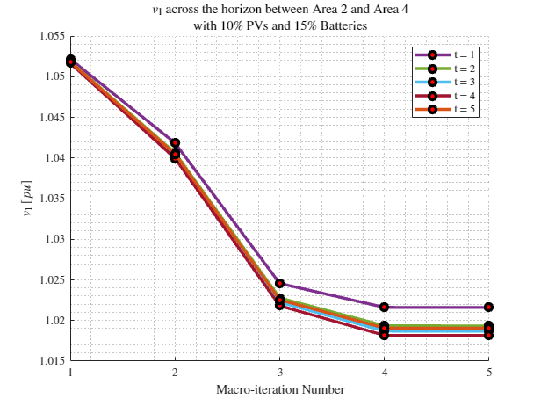
Boundary Voltages
MPDOPF Verified for $T=5, PV=10\%, Batt=15\%$

Slide 16





MPDOPF Verified for $T=10, PV=10\%, Batt=15\%$
strLoadShape = 'New Loadshape.LoadShape npts =10 interval = 1 mult = [0.668 0.705 0.75 0.777 0.787 0.796 0.782 0.783 0.789 0.826]'
strLoadShapePV = 'New Loadshape.LoadShapePV npts =10 interval = 1 mult = [0.2 0.3 0.5 0.8 0.9 1 1 0.99 0.9 0.7]'
MPDOPF Simulation Results
OpenDSS Powerflow Results

Slide 17





MPCOPF Verified for $T=10, PV=10\%, Batt=15\%$
strLoadShape = 'New Loadshape.LoadShape npts =10 interval = 1 mult = [0.668 0.705 0.75 0.777 0.787 0.796 0.782 0.783 0.789 0.826]'
strLoadShapePV = 'New Loadshape.LoadShapePV npts =10 interval = 1 mult = [0.2 0.3 0.5 0.8 0.9 1 1 0.99 0.9 0.7]'
MPCOPF Simulation Results
OpenDSS Powerflow Results

Slide 18






MPDOPF Verified for $T=10, PV=10\%, Batt=15\%$
strLoadShape = 'New Loadshape.LoadShape npts =10 interval = 1 mult = [0.668 0.705 0.75 0.777 0.787 0.796 0.782 0.783 0.789 0.826]'
strLoadShapePV = 'New Loadshape.LoadShapePV npts =10 interval = 1 mult = [0.2 0.3 0.5 0.8 0.9 1 1 0.99 0.9 0.7]'

Slide 19






MPCOPF Verified for $T=10, PV=10\%, Batt=15\%$
strLoadShape = 'New Loadshape.LoadShape npts =10 interval = 1 mult = [0.668 0.705 0.75 0.777 0.787 0.796 0.782 0.783 0.789 0.826]'
strLoadShapePV = 'New Loadshape.LoadShapePV npts =10 interval = 1 mult = [0.2 0.3 0.5 0.8 0.9 1 1 0.99 0.9 0.7]'

Slide 20




Boundary Complex Powers
MPDOPF Verified for $T=10, PV=10\%, Batt=15\%$

Slide 21



Boundary Voltages
MPDOPF Verified for $T=10, PV=10\%, Batt=15\%$

Slide 22

MPDOPF Verified for $T=t, PV=10\%, Batt=15\%$
strLoadShape = 'New Loadshape.LoadShape npts =1 interval = 1 mult = [0.787]'
strLoadShapePV = 'New Loadshape.LoadShapePV npts =1 interval = 1 mult = [0.9]'
MPDOPF Simulation Results
OpenDSS Powerflow Results

Slide 23

MPCOPF Verified for $T=t, PV=10\%, Batt=15\%$
strLoadShape = 'New Loadshape.LoadShape npts =1 interval = 1 mult = [0.787]'
strLoadShapePV = 'New Loadshape.LoadShapePV npts =1 interval = 1 mult = [0.9]'
MPCOPF Simulation Results
OpenDSS Powerflow Results

Slide 24

Latest Slides End Here.
Previous Slides Follow

Slide 25









MPDOPF Verified for $T=1, PV=10\%, Batt=10\%$
strLoadShape = 'New Loadshape.LoadShape npts =1 interval = 1 mult = [0.787]'
strLoadShapePV = 'New Loadshape.LoadShapePV npts =1 interval = 1 mult = [0.9]'
MPDOPF Simulation Results
OpenDSS Powerflow Results
$10\%$GED = $11$ buses

Slide 26








MPCOPF Verified for $T=1, PV=10\%, Batt=10\%$
strLoadShape = 'New Loadshape.LoadShape npts =1 interval = 1 mult = [0.787]'
strLoadShapePV = 'New Loadshape.LoadShapePV npts =1 interval = 1 mult = [0.9]'
MPCOPF Simulation Results
OpenDSS Powerflow Results
$10\%$GED = $11$ buses

Slide 27






MPDOPF Verified for $T=1, PV=100\%, Batt=100\%$
strLoadShape = 'New Loadshape.LoadShape npts =1 interval = 1 mult = [0.787]'
strLoadShapePV = 'New Loadshape.LoadShapePV npts =1 interval = 1 mult = [0.9]'
MPDOPF Simulation Results
OpenDSS Powerflow Results
$100\%$GED = $85$ buses

Slide 28





MPCOPF Verified for $T=1, PV=100\%, Batt=100\%$
strLoadShape = 'New Loadshape.LoadShape npts =1 interval = 1 mult = [0.787]'
strLoadShapePV = 'New Loadshape.LoadShapePV npts =1 interval = 1 mult = [0.9]'
MPCOPF Simulation Results
OpenDSS Powerflow Results
$100\%$GED = $85$ buses

Slide 29






MPDOPF Verified for $T=5, PV=10\%, Batt=10\%$
strLoadShape = 'New Loadshape.LoadShape npts =5 interval = 1 mult = [0.75 0.777 0.787 0.796 0.782]'
strLoadShapePV = 'New Loadshape.LoadShapePV npts =5 interval = 1 mult = [0.5 0.8 0.9 1 1]'
MPDOPF Simulation Results
OpenDSS Powerflow Results
$10\%$GED = $11$ buses

Slide 30






MPCOPF Verified for $T=5, PV=10\%, Batt=10\%$
strLoadShape = 'New Loadshape.LoadShape npts =5 interval = 1 mult = [0.75 0.777 0.787 0.796 0.782]'
strLoadShapePV = 'New Loadshape.LoadShapePV npts =5 interval = 1 mult = [0.5 0.8 0.9 1 1]'
MPCOPF Simulation Results
OpenDSS Powerflow Results
$10\%$GED = $9$ buses

Slide 31





MPDOPF Verified for $T=6, PV=10\%, Batt=10\%$
strLoadShape = 'New Loadshape.LoadShape npts =6 interval = 1 mult = [0.75 0.777 0.787 0.796 0.782 0.783]'
strLoadShapePV = 'New Loadshape.LoadShapePV npts =6 interval = 1 mult = [0.5 0.8 0.9 1 1 0.99]'
MPDOPF Simulation Results
OpenDSS Powerflow Results
$10\%$GED = $11$ buses

Slide 32





MPCOPF Verified for $T=6, PV=10\%, Batt=10\%$
strLoadShape = 'New Loadshape.LoadShape npts =6 interval = 1 mult = [0.75 0.777 0.787 0.796 0.782 0.783]'
strLoadShapePV = 'New Loadshape.LoadShapePV npts =6 interval = 1 mult = [0.5 0.8 0.9 1 1 0.99]'
MPCOPF Simulation Results
OpenDSS Powerflow Results
$10\%$GED = $9$ buses

Slide 33





MPDOPF Verified for $T=7, PV=10\%, Batt=10\%$
strLoadShape = 'New Loadshape.LoadShape npts =7 interval = 1 mult = [0.705 0.75 0.777 0.787 0.796 0.782 0.783]'
strLoadShapePV = 'New Loadshape.LoadShapePV npts =7 interval = 1 mult = [0.3 0.5 0.8 0.9 1 1 0.99]'
MPDOPF Simulation Results
OpenDSS Powerflow Results
$10\%$GED = $11$ buses

Slide 34





MPCOPF Verified for $T=7, PV=10\%, Batt=10\%$
strLoadShape = 'New Loadshape.LoadShape npts =7 interval = 1 mult = [0.705 0.75 0.777 0.787 0.796 0.782 0.783]'
strLoadShapePV = 'New Loadshape.LoadShapePV npts =7 interval = 1 mult = [0.3 0.5 0.8 0.9 1 1 0.99]'
MPCOPF Simulation Results
OpenDSS Powerflow Results
$10\%$GED = $9$ buses

Slide 35





MPDOPF Verified for $T=8, PV=10\%, Batt=10\%$
strLoadShape = 'New Loadshape.LoadShape npts =8 interval = 1 mult = [0.705 0.75 0.777 0.787 0.796 0.782 0.783 0.789]'
strLoadShapePV = 'New Loadshape.LoadShapePV npts =8 interval = 1 mult = [0.3 0.5 0.8 0.9 1 1 0.99 0.9]'
MPDOPF Simulation Results
OpenDSS Powerflow Results
$10\%$GED = $11$ buses

Slide 36





MPCOPF Verified for $T=8, PV=10\%, Batt=10\%$
strLoadShape = 'New Loadshape.LoadShape npts =8 interval = 1 mult = [0.705 0.75 0.777 0.787 0.796 0.782 0.783 0.789]'
strLoadShapePV = 'New Loadshape.LoadShapePV npts =8 interval = 1 mult = [0.3 0.5 0.8 0.9 1 1 0.99 0.9]'
MPCOPF Simulation Results
OpenDSS Powerflow Results
$10\%$GED = $9$ buses

Slide 37





MPDOPF Verified for $T=9, PV=10\%, Batt=10\%$
strLoadShape = 'New Loadshape.LoadShape npts =9 interval = 1 mult = [0.668 0.705 0.75 0.777 0.787 0.796 0.782 0.783 0.789]'
strLoadShapePV = 'New Loadshape.LoadShapePV npts =9 interval = 1 mult = [0.2 0.3 0.5 0.8 0.9 1 1 0.99 0.9]'
MPDOPF Simulation Results
OpenDSS Powerflow Results
$10\%$GED = $11$ buses

Slide 38





MPCOPF Verified for $T=9, PV=10\%, Batt=10\%$
strLoadShape = 'New Loadshape.LoadShape npts =9 interval = 1 mult = [0.668 0.705 0.75 0.777 0.787 0.796 0.782 0.783 0.789]'
strLoadShapePV = 'New Loadshape.LoadShapePV npts =9 interval = 1 mult = [0.2 0.3 0.5 0.8 0.9 1 1 0.99 0.9]'
MPCOPF Simulation Results
OpenDSS Powerflow Results
$10\%$GED = $9$ buses

Slide 39





MPDOPF Verified for $T=10, PV=10\%, Batt=10\%$
strLoadShape = 'New Loadshape.LoadShape npts =10 interval = 1 mult = [0.668 0.705 0.75 0.777 0.787 0.796 0.782 0.783 0.789 0.826]'
strLoadShapePV = 'New Loadshape.LoadShapePV npts =10 interval = 1 mult = [0.2 0.3 0.5 0.8 0.9 1 1 0.99 0.9 0.7]'
MPDOPF Simulation Results
OpenDSS Powerflow Results
$10\%$GED = $11$ buses

Slide 40





MPCOPF Verified for $T=10, PV=10\%, Batt=10\%$
strLoadShape = 'New Loadshape.LoadShape npts =10 interval = 1 mult = [0.668 0.705 0.75 0.777 0.787 0.796 0.782 0.783 0.789 0.826]'
strLoadShapePV = 'New Loadshape.LoadShapePV npts =10 interval = 1 mult = [0.2 0.3 0.5 0.8 0.9 1 1 0.99 0.9 0.7]'
MPCOPF Simulation Results
OpenDSS Powerflow Results
$10\%$GED = $9$ buses

Slide 41





MPDOPF Verified for $T=10, PV=10\%, Batt=10\%$
strLoadShape = 'New Loadshape.LoadShape npts =10 interval = 1 mult = [0.668 0.705 0.75 0.777 0.787 0.796 0.782 0.783 0.789 0.826]'
strLoadShapePV = 'New Loadshape.LoadShapePV npts =10 interval = 1 mult = [0.2 0.3 0.5 0.8 0.9 1 1 0.99 0.9 0.7]'

Slide 42



Boundary Complex Powers

Slide 43



Boundary Voltages

Slide 44





MPDOPF Verified for $T=11, PV=10\%, Batt=10\%$
strLoadShape = 'New Loadshape.LoadShape npts =11 interval = 1 mult = [0.644 0.668 0.705 0.75 0.777 0.787 0.796 0.782 0.783 0.789 0.826]'
strLoadShapePV = 'New Loadshape.LoadShapePV npts =11 interval = 1 mult = [0.1 0.2 0.3 0.5 0.8 0.9 1 1 0.99 0.9 0.7]'
MPDOPF Simulation Results
OpenDSS Powerflow Results
$10\%$GED = $11$ buses

Slide 45





MPCOPF Verified for $T=11, PV=10\%, Batt=10\%$
strLoadShape = 'New Loadshape.LoadShape npts =11 interval = 1 mult = [0.644 0.668 0.705 0.75 0.777 0.787 0.796 0.782 0.783 0.789 0.826]'
strLoadShapePV = 'New Loadshape.LoadShapePV npts =11 interval = 1 mult = [0.1 0.2 0.3 0.5 0.8 0.9 1 1 0.99 0.9 0.7]'
MPCOPF Simulation Results
OpenDSS Powerflow Results
$10\%$GED = $9$ buses

Slide 46


MPDOPF Verification: $$T=1, PV=30\%, Batt=30\%$$

Slide 47





MPDOPF Verified for $T=1, PV=30\%, Batt=30\%$
MPDOPF Simulation Results
OpenDSS Powerflow Results

Slide 48



MPDOPF Verification: $$T=2, PV=30\%, Batt=30\%$$

Slide 49






MPDOPF Verified for $T=2, PV=30\%, Batt=30\%$
MPDOPF Simulation Results
OpenDSS Powerflow Results

Slide 50




MPDOPF Verification: $$T=3, PV=10\%, Batt=10\%$$

Slide 51






MPDOPF Verified for $T=3, PV=10\%, Batt=10\%$
MPDOPF Simulation Results
OpenDSS Powerflow Results

Slide 52



MPDOPF Verification: $$T=4, PV=10\%, Batt=10\%$$

Slide 53






MPDOPF Verified for $T=4, PV=10\%, Batt=10\%$
strLoadShape = 'New Loadshape.LoadShape npts =4 interval = 1 mult = [0.777 0.787 0.796 0.782]'
strLoadShapePV = 'New Loadshape.LoadShapePV npts =4 interval = 1 mult = [0.8 0.9 1 1]'
MPDOPF Simulation Results
OpenDSS Powerflow Results

Slide 54



MPDOPF Verification: $$T=5, PV=10\%, Batt=10\%$$

Slide 55



MPDOPF Verification: $$T=5, PV=30\%, Batt=30\%$$

Slide 56





MPCOPF $T=5, PV=30\%, Batt=30\%$

Slide 57



MPDOPF Verification: $$T=5, PV=50\%, Batt=50\%$$

Slide 58





MPCOPF $T=5, PV=50\%, Batt=50\%$ sim terminated at 100 micro-iterations

Slide 59



MPDOPF Verification: $$T=5, PV=100\%, Batt=100\%$$

Slide 60



MPDOPF Verification: $$T=6, PV=10\%, Batt=10\%$$

Slide 61






MPDOPF Verified for $T=5, PV=30\%, Batt=30\%$
strLoadShape = 'New Loadshape.LoadShape npts =5 interval = 1 mult = [0.75 0.777 0.787 0.796 0.782]'
strLoadShapePV = 'New Loadshape.LoadShapePV npts =5 interval = 1 mult = [0.5 0.8 0.9 1 1]'
MPDOPF Simulation Results
OpenDSS Powerflow Results

Slide 62






MPDOPF Verified for $T=5, PV=50\%, Batt=50\%$
strLoadShape = 'New Loadshape.LoadShape npts =5 interval = 1 mult = [0.75 0.777 0.787 0.796 0.782]'
strLoadShapePV = 'New Loadshape.LoadShapePV npts =5 interval = 1 mult = [0.5 0.8 0.9 1 1]'
MPDOPF Simulation Results
OpenDSS Powerflow Results

Slide 63






MPDOPF Verified for $T=5, PV=100\%, Batt=100\%$
strLoadShape = 'New Loadshape.LoadShape npts =5 interval = 1 mult = [0.75 0.777 0.787 0.796 0.782]'
strLoadShapePV = 'New Loadshape.LoadShapePV npts =5 interval = 1 mult = [0.5 0.8 0.9 1 1]'
MPDOPF Simulation Results
OpenDSS Powerflow Results

Slide 64


MPDOPF: Mapping of Decentralized Variables to Centralized Variables done, everything packed into a structure suitable for OpenDSS Validation.
I had node numbers for $4$ Areas like $1:41$, $1:19, 1:20, 1:54$ but not a way to know which nodes do they refer to in the real ‘centralized’ system.
I (manually) created a mapping between the two.
I then used the mapping scheme to collate all ‘area information’ after optimization into a ‘system information’ for validating against OpenDSS.

Slide 65

How do other authors validate their OPF results?
[nazir2020tpwrs]
Feasibility of Solution: Forward-Backward Sweep in GridLab-D.
They check violation of node voltages between the simulation and the GridLab-D powerflow.
Optimality of Solution:
The authors argue that a) computing (even for verifying) Multi-Period NL OPF can be computationally too expensive and b) the solution to a ‘Decoupled’ NL-OPF (with battery set points already assigned by the Full Horizon SOCP OPF will provide an even lower optimal value compared to the Full Horizon NLP OPF (7).

Slide 66


How do other authors validate their OPF results?
[nazir2020tpwrs]
Optimality of Solution:
They formulate their optimality gap as a comparison between the SOCP optimal value and Decoupled NLP optimal value (9), for each time-step, and taking the maximum optimality gap to show as the result.
For IEEE 123, they get a maximum optimality gap of $2.1\%$. Violations against GridLab-D are small. (Feasible solution).

Slide 67

How do other authors validate their OPF results?
[nazir2020tpwrs]
Commentary on Solution Times:
Fig. (a) They see a similar trend in results as me when performing a Full Horizon NLP, with solution times becoming increasingly larger as the time-horizon increases.
Fig. (b) But their SOCP approach scales well, with solutions times increasingly almost linearly with time-horizon. For practical scenarios (day-ahead hourly simulation), their SOCP solution converges in under a minute.

Slide 68


How do other authors validate their OPF results?
[usman2022tpwrs]
Feasibility and Optimality of Solution:
They mainly showcase the benchmarks based on UK $31$ bus system.
They solve the full horizon (day-ahead hourly) OPF MINLP OPF in JuMP using BONMIN solver (here called $M0$).
They compare its objective function against their own linearized method (here called $M1$).
They get an optimality gap of less than $1\%$.
Infeasibilities are detected based on box-constraints (line-limits breached, bus voltage limits breached, etc.).

Slide 69
How do other authors validate their OPF results?
[agrawal2022tpwrs]
Other authors, sometimes use a different solution paradigm, and compare it against MATLAB’s fmincon.

Slide 70






MPCOPF Simulation has been verified for X% PVs and Y% Batteries Only for small horizons ($T≤8$) because of long simulation time.

Slide 71




$$T=1, PV=10\%, Batt=10\%$$

Slide 72





$$T=2, PV=10\%, Batt=10\%$$

Slide 73




$$T=2, PV=30\%, Batt=30\%$$

Slide 74





$$T=3, PV=10\%, Batt=10\%$$

Slide 75





$$T=4, PV=10\%, Batt=10\%$$

Slide 76





$$T=5, PV=10\%, Batt=10\%$$

Slide 77

$$T=5, PV=30\%, Batt=30\%$$

Slide 78


$$T=5, PV=30\%, Batt=30\%$$

Slide 79

$$T=5, PV=50\%, Batt=50\%$$ sim terminated at 100 micro-iterations

Slide 80


$$T=5, PV=50\%, Batt=50\%$$ sim terminated at 100 micro-iterations

Slide 81





$$T=6, PV=10\%, Batt=10\%$$

Slide 82


$$T=6, PV=10\%, Batt=10\%$$

Slide 83





$$T=7,PV=10\%, Batt=10\%$$

Slide 84





$$T=8,PV=10\%, Batt=10\%$$

Slide 85


$$T=8,PV=10\%, Batt=10\%$$

Slide 86





$$T=9,PV=10\%, Batt=10\%$$

Slide 87




$$T=1, PV=30\%, Batt=30\%$$

Slide 88





$$T=6, PV=30\%, Batt=30\%$$

Slide 89





$$T=6, PV=50\%, Batt=50\%$$

Slide 90

MPCOPF Simulation has been verified for X% PVs and Y% Batteries Only for small horizons ($T=5$) because of long simulation time.
MPCOPF Simulation Results
These slides will show results for a $5$-hour (hourly) $10\%$ PV $+ 10\%$Battery Simulation Validation for IEEE $123$ system, but I’ve validated for many other percentage penetrations too, for smaller time-steps.
For example, even this simulation took $500$ seconds on my $32$GB Office PC.
Even for the same $T$, increasing the GED penetration % increases the OPF solution time.
And even for small GED penetration percentage (10% each like the one done in these slides), increasing $T$ increases the simulation time by a lot.

Slide 91





MPCOPF Simulation has been verified for X% PVs and Y% Batteries Only for small horizons ($T≤5$) because of long simulation time.
MPCOPF Simulation Results
OpenDSS Powerflow Results
$10\%$ PVs + $10\%$ Batteries

Slide 92



Current Issue: Some mismatch in MPCOPF results Seeming mismatch between specified (from OPF) and assigned values (into OpenDSS) for Battery Reactive Powers

Slide 93




Currently Doing: Extracting Results on an Hourly (Time-step) Basis, for hourly comparison against OpenDSS

Slide 94





IEEE $123 X\%$PVs, $0\%$Batteries. COPF. $T = 1$
Objective Function values (Real Power Losses $P_{Loss}$) and System-wide Voltage snapshots (shown in the next slides) match.
This slide: $X=0$
Multi-Period Simulation, T = 1, Batteries at 0%, DERs at 0% ($0$ buses)
OpenDSS Powerflow with DERs at 0% ($0$ buses)

Slide 95




IEEE $123 X\%$PVs, $0\%$Batteries. COPF. $T = 1$
Objective Function values (Real Power Losses $P_{Loss}$) and System-wide Voltage snapshots (shown in the next slides) match.
This slide: $X=50$
Multi-Period Simulation, T = 1, Batteries at 0%, DERs at 50% ($43$ buses)
OpenDSS Powerflow with DERs at 50% ($43$ buses)

Slide 96




IEEE $123 X\%$PVs, $0\%$Batteries. COPF. $T = 1$
Objective Function values (Real Power Losses $P_{Loss}$) and System-wide Voltage snapshots (shown in the next slides) match.
This slide: $X=100$
Multi-Period Simulation, T = 1, Batteries at 0%, DERs at 100% ($85$ buses)
OpenDSS Powerflow with DERs at 100% ($85$ buses)

Slide 97







Comparison with OpenDSS: System-wide Voltage Snapshots PV = $0\%, 10\%, 20\%, 30\%, 40\%, 50\%$ Battery = $0\%$ $$T = 1$$

Slide 98






Comparison with OpenDSS: System-wide Voltage Snapshots PV = $60\%, 70\%, 80\%, 90\%, 100\%,$ Battery = $0\%$ $$T = 1$$

Slide 99






Comparison with OpenDSS: System-wide Voltage Snapshots Battery = $10\%, 20\%, 30\%, 40\%, 50\%$ PV = $0\%$ $$T = 1$$

Slide 100






Comparison with OpenDSS: System-wide Voltage Snapshots
PV = $0\%$ Battery = $60\%, 70\%, 80\%, 90\%, 100\%,$ $$T = 1$$

Slide 101






Comparison with OpenDSS: System-wide Voltage Snapshots
PV and Battery = $0\%, 10\%, 30\%, 50\%, 100\%$ $$T = 1$$

Slide 102






Trying to benchmark the “Benchmark” Simulation against the “Original” Simulation
$T$: Number of Time-Periods (tunable)
No Time-dimension: Equivalent to $T=1$
$numAreas$ : Number of Areas the system is divided into. The simulation becomes:
CMPOPF if $numAreas = 1$
DMPOPF if $numAreas > 1 (4)$
$numAreas$ : Number of Areas the system is divided into. The simulation becomes:
CMPOPF if $numAreas = 1$
DMPOPF if $numAreas > 1 (4)$
DERs (tunable): $[0, 100\%]$ ($0$ to $85$ buses)
Batteries# (tunable*): $[0, 100\%]$ ($0$ to $85$buses)
DERs (fixed): $100\%$ ($85$ buses)
No Batteries: Equivalent to $0\%$ ($0$ buses)
“Benchmark” Simulation: MP-(C/D)-OPF
“Original” Simulation: (C/D)-OPF

Slide 103








Trying to benchmark the “Benchmark” Simulation against the “Original” Simulation
#Batteries add more than just $4$ new decision variables (which are $B, P_{c}, P_{d}, q_{B}$) to the simulation.
Incorporating them (while avoiding mixed-integer programming) requires specifying additional ‘soft-constraint’ objective functions to the optimizer, including an “SCD penalty” function and a “Deviation of terminal SOC from a reference SOC penalty” function, which require additional unknown parameters (such as $α, γ$ in my simulation). Ideally, these ‘soft-constraint’ function values in the result should be zero, but if this doesn’t happen, they cannot be truly compared to a ‘battery-free’ simulation.
$T$: Number of Time-Periods (tunable)
No Time-dimension: Like $T=1$
$numAreas$ : Number of Areas the system is divided into. The simulation becomes:
CMPOPF if $numAreas = 1$
DMPOPF if $numAreas > 1 (4)$
$numAreas$ : Number of Areas the system is divided into. The simulation becomes:
CMPOPF if $numAreas = 1$
DMPOPF if $numAreas > 1 (4)$
DERs (tunable): $[0, 100\%]$ ($0$ to $85$ buses)
Batteries# (tunable*): $[0, 100\%]$ ($0$ to $85$buses)
DERs (fixed): $100\%$ ($85$ buses)
No Batteries: Like $0\%$ ($0$ buses)
“Benchmark” Simulation: MP-(C/D)-OPF
“Original” Simulation: (C/D)-OPF
*Note: The way the batteries are currently modeled, they can only be placed at a bus where there is already a DER. (So only $85$ buses are eligible to have a battery)

Slide 104







Trying to benchmark the “Benchmark” Simulation against the “Original” Simulation
But, if batteries are removed (unmodeled) from the MPOPF simulation, the previously mentioned complications are also avoided, and thus the two simulations can be compared toe-to-toe. This is what I’ve been doing recently.
$T$: Number of Time-Periods (tunable)
$$T=1$$
$numAreas=1$ (COPF)
$$\%DER=100$$
$$\%Batteries=0$$
No Time-dimension: Equivalent to $T=1$
$numAreas$ : Number of Areas the system is divided into. The simulation becomes:
CMPOPF if $numAreas = 1$
DMPOPF if $numAreas > 1 (4)$
$numAreas$ : Number of Areas the system is divided into. The simulation becomes:
CMPOPF if $numAreas = 1$
DMPOPF if $numAreas > 1 (4)$
DERs (tunable): $[0, 100\%]$ ($0$ to $85$ buses)
Batteries# (tunable*): $[0, 100\%]$ ($0$ to $85$buses)
DERs (fixed): $100\%$ ($85$ buses)
No Batteries: Equivalent to $0\%$ ($0$ buses)
“Benchmark” Simulation: MP-(C/D)-OPF
“Original” Simulation: (C/D)-OPF

Slide 105


IEEE $123 100\%$DER, $0\%$Batteries. COPF. $T = 1$
Current Status: My MPCOPF line loss result matches with the previous COPF line loss results, which still is a little off the OpenDSS line loss. Voltages (on the next page) match closely, but not completely. I don’t know the cause of the slight mismatch. (and whether it will blow up for bigger simulations, or not be an issue)
Multi-Period Simulation, T = 1, Batteries at 0%, DERs at 100% ($85$ buses)
OpenDSS Powerflow with DERs at 100% ($85$ buses)

Slide 106


Comparison with OpenDSS

Slide 107




IEEE $123 100\%$DER, $0\%$Batteries. COPF. $T = 1$
Problem: These values should be the same. This is an OPF modelling issue.
Multi-Period Simulation, T = 1, Batteries at 0%, DERs at 100% ($85$ buses)
Original Simulation* DERs at 100% ($85$ buses)
* Original Simulation = Simulation used by Rabayet to model DOPF on IEEE $123$ Bus System with $100\%$ DERs ($85$ buses). Obviously, there’s no element of time $($not modeled, so $T=1)$ and no batteries (not modeled, so $0\%$)

Slide 108

Current Approach: Validating OPF decision variables with OpenDSS
By setting
$P_{Load_OpenDSS}=P_{Load} −P_{DER} −P_{disch}+P_{chr}$
$Q_{Load_OpenDSS}=Q_{Load} −q_{DER} −q_{Batt}−Q_{Cap}$
Running Powerflow in OpenDSS, obtaining $V_{OpenDSS}$ and comparing against my simulation $V_{results}$ (checking for physical violations, but also, just checking the two $V$vs bus-number curves in general).
I’m writing an OpenDSS validator function, which takes busData, branchData, $P_{Load}, P_{DER}, P_{disch}, P_{chr}, Q_{Load}, q_{DER}, q_{Batt}, Q_{cap}, V_{results}$ for a given time-interval $t$and plots its powerflow voltages $V_{OpenDSS}$ against my $V_{results}$.

Slide 109

Comparison with OpenDSS confirms that the current MPCOPF model has issues

Slide 110
References
[nazir2018pscc] Nazir, N., & Almassalkhi, M. . Receding-Horizon Optimization of Unbalanced Distribution Systems with Time-Scale Separation for Discrete and Continuous Control Devices. 2018 Power Systems Computation Conference (PSCC). IEEE. doi: 10.23919/PSCC.2018.8442555
[nazir2020tpwrs] Nazir, N., Racherla, P., & Almassalkhi, M. (2020). Optimal Multi-Period Dispatch of Distributed Energy Resources in Unbalanced Distribution Feeders. IEEE Trans. Power Syst., 35(4), 2683–2692. doi: 10.1109/TPWRS.2019.2963249
[usman2022tpwrs] Usman, M., & Capitanescu, F. (2022). A Novel Tractable Methodology to Stochastic Multi-Period AC OPF in Active Distribution Systems Using Sequential Linearization Algorithm. IEEE Trans. Power Syst., 38(4), 3869–3883. doi: 10.1109/TPWRS.2022.3197884

